Slide 1
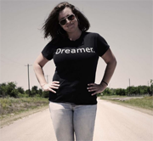
It’s Not Just Business, It’s Personal
Liz Deering, Co-Founder of The Un.Inc @n_deering @uninclife
Notes:
My name is Liz Deering
I’m the CoFounder of The Un.Inc
I’ve been a full time social entrepreneur for the last 10 years
My passion is holding space for founders to find their voice and build self sustaining life around their passions
Ally, advocate…

Slide 2
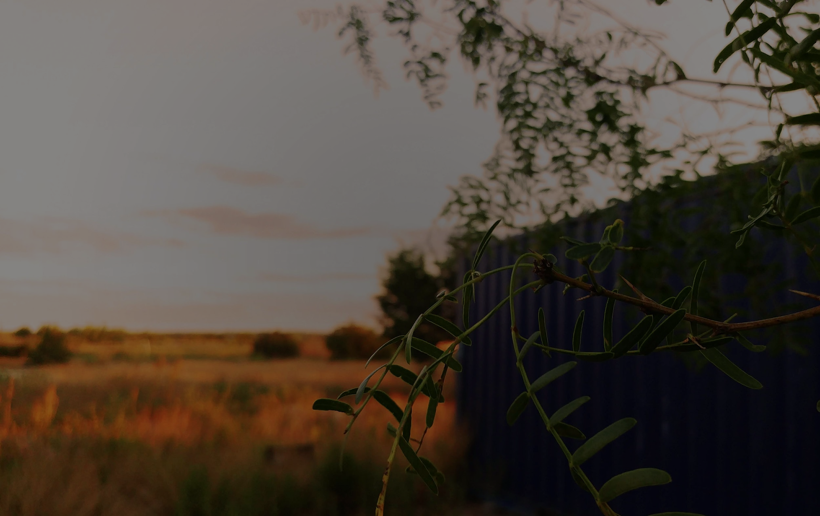
THE UN.INC - Austin TX
We believe that the future of social impact lies in the hands of diverse and creative founders - the rebels, misfits, artists, creators and dreamers with the heart and tenacity to literally change the world.
Notes:
The Un.Inc is an unconventional path for founders to claim their purpose and thrive
We do that with programs like the cohort, spaces including our new 9 acre space in Austin and events
History
We’ve been at it for 2 years
100 founders. 200 mentors

Slide 3
Digging In
Journal Discuss Share
@uninclife
Notes:
Today we’ll be diving into your passion and connecting it to your work
Share as much as you like
This is a taste of what we do in our cohort curriculum
Test the audienice - raise your hand if you are a full time entrepreneur. Raise your hand if you want to be one.
How do you define an impact business?

Slide 4
Born from Pain
“The wound is the place where the light enters you.”
Rumi
@uninclife

Slide 5
Suffering
Think back to a time when you experienced deep suffering. What happened?
@uninclife

Slide 6
Choice
In that moment, you may have had a realization or made a choice. What did you decide for yourself?
@uninclife

Slide 7
Fear
“Fear is a natural reaction to moving closer to the truth.”
Pema Chödrön
@uninclife
Notes:
Share with the group - choose a few folks

Slide 8
We Are Here
“We are here to hold the space for the creators, to walk alongside the lonely ones who will change the world.”
@uninclife

Slide 9
Connect
What’s your name?
What are you most passionate about?
How can the group help you?
@uninclife

Slide 10
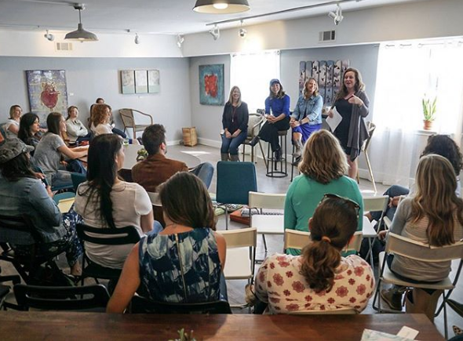
THE UN.INC www.theuninc.com @uninclife
Liz Deering, Co-Founder @n_deering liz@theunincubator.com
@uninclife
Notes:
Soma Vida
Launching our classes and cohort this summer

