Slide 1
CHOOSING A BUSINESS ENTITY
LEGAL BENEFITS
&
TAX ADVANTAGES

Slide 2
Protect Your Business from the Flu
Vaccinate Your New Business Against Lurking Viruses
Such as…..

Slide 3
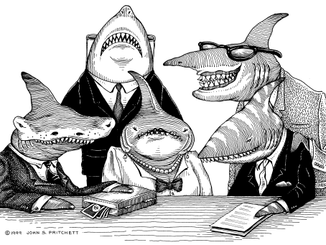
Plaintiff Lawyers
Or…

Slide 4
Personal Creditors Taking Your Hard Earned Money
Or Worst of all………..

Slide 5
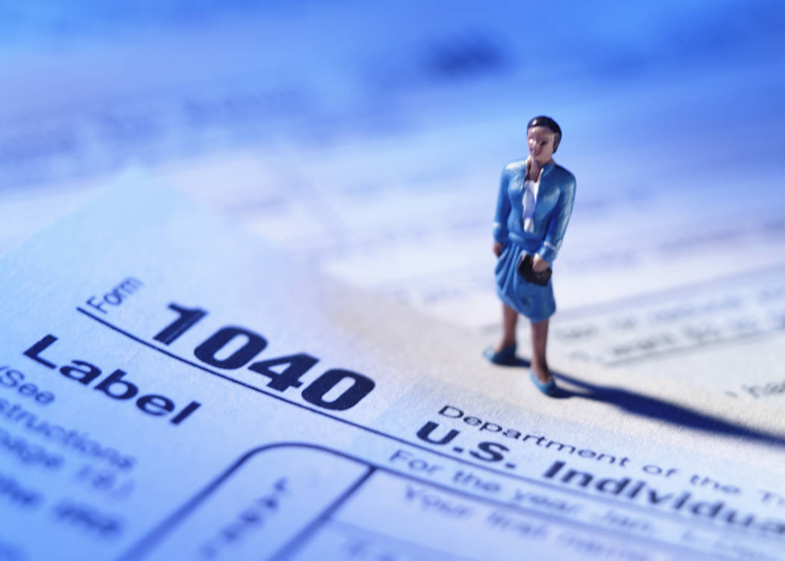
Paying the Government More Taxes
Than You Legally Have to!!

Slide 6
If You Don’t Have Money to Burn
Then You Need to Carefully Consider the Tax Advantages to Having
A Formal Business Entity Such as a Limited Liability Company or a
Subchapter S Corporation

Slide 7
And If That’s Not Enough Reasons Yet
Let Me Give You a Few More

Slide 8
And This Will Be You..
The Successful Entrepreneur!!

