Slide 1
@Jessica_Markets @hotdogmarketing

Slide 2
What You Do for Your Business Online Matters
Search Engines drive 94% of all website traffic.
94% of that search engine traffic is Google.
90% of searchers haven’t made up their mind about a brand when they start their search.
50% of people are more likely to click on a brand name if that brand name shows up more than once in a search result.

Slide 3
The Social Media Machine
Grow Your Brand with Online Marketing

Slide 4
What Google Cares About
Proximity to the Searcher
Prominence of the Website/Brand in the Results
Relevancy of the Result to the Inquiry

Slide 5
Establish Your Business as the Most Relevant and Obvious Choice Online.

Slide 6
I need to blow my nose. I need to catch a ride. I want to eat a taco.
Kleenex
UBER
Torchy’s
Taco Bell

Slide 7
Notes:
The market place is crowded. Let’s talk about Oreo and the grocery store really quick to see if I can draw an analogy between what large brands can afford to do and what smaller brands need to do.

Slide 9
Your Benchmarks
Website Traffic from Referral Sites
Return Visits to the Site
Length of Time Spent on the Website
Website Traffic from Organic Search

Slide 10
Website Traffic From Referral Sites
Social Media
Backlinks

Slide 11
Hub and Spoke
The Website
Facebook
Twitter
Email
Traditional Marketing
Events
Review Sites
Other Websites and Blogs
News and Press Releases

Slide 12
Myths About Social Media
Social Media is Free.
You Need to Be on All Social Media All the Time.
You Need a Lot of Social Media Followers for It to Work.

Slide 14
Be Consistent!

Slide 15
Which Kind of Content Gets Shared More on Social?
Text only.
Text with URL links.
Photos.
Videos.

Slide 16
Video Spreads 1200% More

Slide 17
Your Content Should ...
Add Value to Their Lives
Be Easy to Understand
Trigger an Emotional Response
Appeal to a Personality Trait You Know About Them
Be Funny
Incentivize Them to Do More with Your Content than Just Look at It

Slide 18
Managing a Schedule

Slide 19
Be Consistent!

Slide 20
Backlinks: The Other Referral Traffic
Other sites that rank for your keyword terms (usually review sites)
Publication Sites (like magazines, blogs or business’s the publish content regularly)

Slide 21
Online Reviews
88% of people trust an online review as much as an in-person recommendation.
14% of people use a company with 1-2 Stars.
57% of people would use a company with 3 stars.
94% would use a company with 4-5 Stars.

Slide 22
The Marketing Loop
Reviews
Website
Service & Products
Branding
Feedback

Slide 23
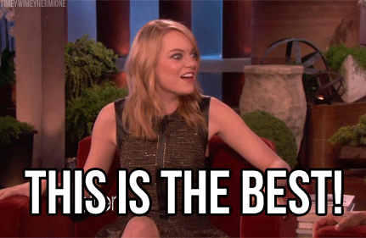
Backlinks from Other Sites
Blogs
Forums
News Sources
Google News
Other Businesses
Non-Profits
Community Sites
Event Websites

Slide 24
Website Traffic From Return Visitors
Email Marketing
Retargeting
… Social Media, Again!

Slide 25
Your Benchmarks
Website Traffic from Referral Sites
Return Visits to the Site
Length of Time Spent on the Website
Website Traffic from Organic Search

Slide 26
90% of website visitors are only there to do research.

Slide 28
Social Media for Return Visitors
TOFU Traffic: Brand Awareness Advertising, Follow/Audience Building Campaigns
MOFU Traffic: Engagement Campaigns, Content Campaigns, Website Traffic Campaigns
BOFU Traffic: Call to Action Campaigns, Retargeting Campaigns, Highly Targeted Promotions

Slide 29
… Social Media, Again!
Be Consistent!

Slide 30
Email Marketing
Promotions and Discounts
Low risk offers “Download this for free or cheap”
Educational pieces
Newsletters/Community Engagement emails

Slide 31
The Biggest Myth About Email Marketing
People Hate Email.
Therefore, People Will Hate My Business if I send an Email.
I Will Be Annoying.

Slide 32
Be Consistent!

Slide 33
Retargeting

Slide 34
Increasing Time on the Website
Branding and Design
Content
Good Technical Set-Up

Slide 35
Your Benchmarks
Website Traffic from Referral Sites
Return Visits to the Site
Length of Time Spent on the Website
Website Traffic from Organic Search

Slide 36
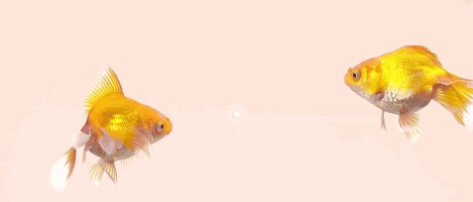
Human Attention Span: 8 Seconds Goldfish Attention Span: 9 Seconds Make a Brand Impression: 10 Seconds

Slide 37
Before

Slide 38
After

Slide 39
Before

Slide 40
After

Slide 41
Before

Slide 42
After

Slide 43
Good Content
What makes your business special?
What are the top 3-5 things you want people to know about your business right away?
What information is important in making a decision?
Is it pricing?
Is it location?
Is it more education on how it all works?
Is it a complete list of services?
What kind of content do your competitors have? Not the bad ones, the ones you’re aspiring to?

Slide 44
Good Technical Set-Up
Mobile Responsive
Site Speed

Slide 45
Mobile-Responsive

Slide 46
Design Mobile-First.
Borrow from Good App Design.

Slide 47
Keep Adding Content
But PLEASE Shorten the Headlines!
10 Simple Ways To Show Your Spouse How Much You Love Them
10 Simple Ways To Show Your Spouse How Much You Love Them
10 Simple Ways To Love Your Spouse

Slide 48
Optimize for SEO
And Voice Search
See our top camera reviews for 2019
What is the best camera to buy in 2019?

Slide 49
Human Attention Span: 8 Seconds Goldfish Attention Span: 9 Seconds Make a Brand Impression: 10 Seconds

Slide 50
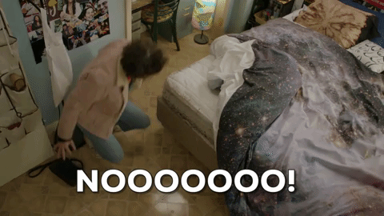
Speed is Key.
If it Doesn’t Load Instantly . . .
Notes:
You have about 1-3 seconds to make this really work on a phone.
You have about seven seconds before you lose over 30% of your website traffic due to a slow loading site. Run your site through Google’s site speed test and see how you’re doing. Go outside and try to load your site on your phone. Is it a frustrating experience?
Your visitors will look at five times more content if your pages load in three seconds or less. Here’s what you need to think about to help with your new project:
Don’t skimp on getting a good developer. Relying 100% on premade plugins and themes could be causing a lot of extra bulk to your site that slows it down. A good developer will code things to load the way they should without the bulk. Everyone worries about a good design, but a good developer is crucial.
Look at SVGs instead of embedding traditional images (see explanation below).
Make sure your hosting provider is supplying enough resources to your site and is set-up to handle your site efficiently.

Slide 51
Site Load Time Before You Lose 32% of Your Clickers:
7 seconds.

Slide 52
People Leave a Site: 7 Seconds Human Attention Span: 8 Seconds Goldfish Attention Span: 9 Seconds Make a Brand Impression: 10 Seconds

Slide 53
Establish Your Business as the Most Relevant and Obvious Choice Online.

Slide 54
Your Benchmarks
Website Traffic from Referral Sites
Return Visits to the Site
Length of Time Spent on the Website
Website Traffic from Organic Search

Slide 55
The Reward
Brand Equity

Slide 56
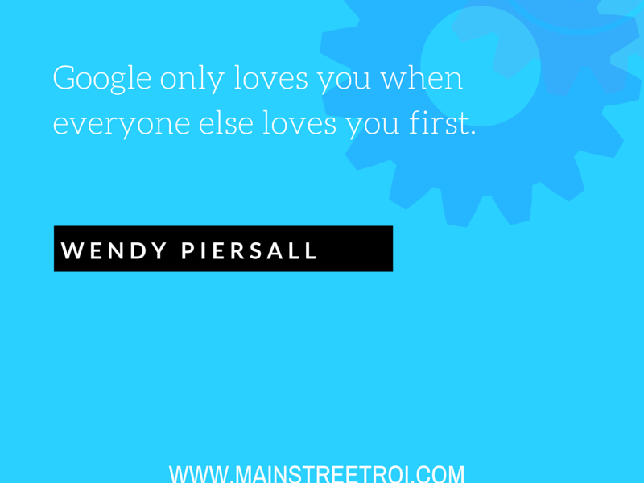

Slide 57
Stay In-Touch
Twitter: @Jessica_Markets
Hot Dog Marketing:
Twitter: @hotdogmarketing
fb.com/hotdogmarketing
HotDogMarketing.net

