Slide 1
Accounting for Management Decisions
INNOVATION WEEK 2019

Slide 2
Benchmarks
Benchmarking is a process that develops performance indices for specific entities and compares them to internal targets or industry norms for the purpose of measuring entity performance and identifying areas needing improvement.

Slide 3
MANAGERIAL ACCOUNTING
CASE STUDY
$1,200,000
$540,000
$660,000
$600,000
$60,000
Revenue
(Sales)
Cost of Goods Sold (COGS)
Gross Profit
Operating Expenses (OPEX)
Operating Profit/Loss (EBITDA)
Bottom Line
WWW.JPGTEAM.COM

Slide 4
KPIs & Metrics
A Key Performance Indicator (KPI) is a measurable value that demonstrates how effectively a company is achieving key business objectives.
A Business Metric is a quantifiable measure that is used to track and assess the status of a specific business process.
Every area of business has specific metrics that should be monitored
Marketing metrics : tracking campaign
Program statistics
Sales metrics: new opportunities and leads
Executive metrics: big picture on financials

Slide 5
Financial Metrics
CASE STUDY: YR 1
100%
45%
55%
50%
5%
Revenue
Cost of Goods Sold
Gross Profit
Operating Expense
(OPEX)
Operating Profit/Loss
(EBITDA)
% |  | GOALS | Actual | Δ | YR1 | Δ | YR2 | %
100% | Revenue | 5% | $1,200,000 | 5% | $1,260,000 | 5% | $1,323,000 | 100%
45% | COGS | -1% | $540,000 | 7% | $579,600 | 0% | $582,120 | 44%
55% | Gross Profit |  | $660,000 | 3% | $680,400 | 9% | $740,880 | 56%
50% | OPEX | -2% | $600,000 | 1% | $604,800 | 5% | $635,040 | 48%
5% | EBITDA |  | $60,000 | 26% | $75,600 | 40% | $105,840 | 8%
WWW.JPGTEAM.COM

Slide 6
Financial Metrics
CASE STUDY: YR2
EBITDA
COGS
$105,840 – 8%
$582,120 – 44%
OPEX
$635,040 – 48%
WWW.JPGTEAM.COM

Slide 7
Financial Metrics
CASE STUDY: YR1
100%
45%
55%
50%
5%
Revenue
Cost of Goods Sold
Gross Profit
Operating Expense
(OPEX)
Operating Profit/Loss
(EBITDA)
Actual% |  | GOALS | Actual | Δ | YR1 | Δ | YR2 | %
100% | Revenue | 1% | $1,200,000 | 1% | $1,212,000 | 1% | $1,224,120 | 93%
45% | COGS | -5% | $540,000 | -10% | $484,800 | 1% | $489,648 | 37%
55% | Gross Profit |  | $660,000 | 10% | $727,200 | 1% | $734,472 | 56%
50% | OPEX | -7% | $600,000 | -13% | $521,160 | 1% | $526,372 | 40%
5% | EBITDA |  | $60,000 | 243% | $206,040 | 1% | $208,100 | 16%
WWW.JPGTEAM.COM

Slide 8
Financial Metrics
CASE STUDY: YR2
EBITDA
COGS
$208,100 – 16%
$489,648 – 37%
OPEX
$526,372 – 40%
WWW.JPGTEAM.COM

Slide 9
SALES FORECAST
 | GOALS | Actual | Δ | YR1 | Δ | YR2
Revenue | 1% | $1,200,000 | 1% | $1,212,000 | 1% | $1,224,120
COGS | -5% | $540,000 | -10% | $484,800 | 1% | $489,648
Gross Profit |  | $660,000 | 10% | $727,200 | 1% | $734,472
ANNUAL SALES & GROSS PROFIT
WWW.JPGTEAM.COM

Slide 10
USE OF FUNDS
CASE STUDY: STARTUP
LEASE DEPOSIT 1%
INITIAL LEASE PAYMENTS 3%
FF&E 24%
MISCELLANEOUS COSTS 8%
IMPROVEMENTS 20%
WEBSITE DEVELOPMENT 2%
FIXED STARTUP EXPENSES
RETAIL BUSINESS INSURANCE 2%
WORKING CAPITAL 28%
MARKETING 4%
COFFEE SUPLIES INVENTORY 8%
WWW.JPGTEAM.COM

Slide 11
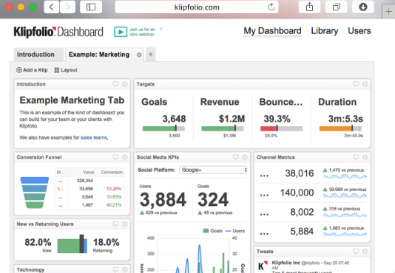
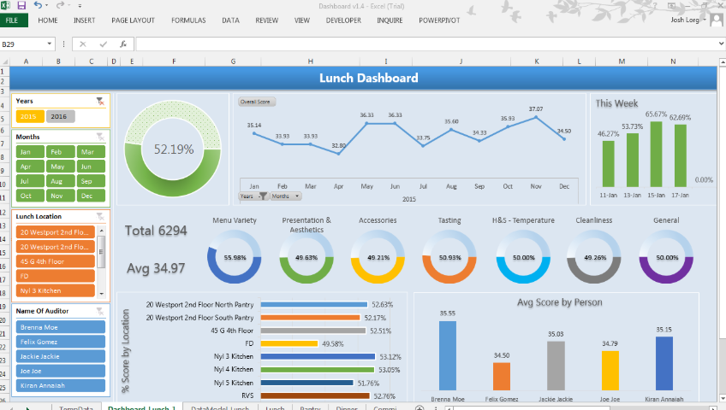
Resources & Samples
WWW.JPGTEAM.COM

Slide 12
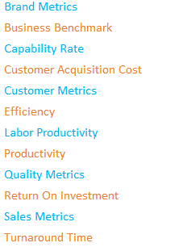
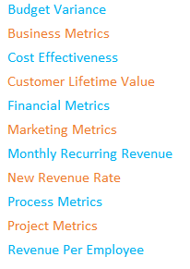
Resources & Samples
WWW.JPGTEAM.COM

Slide 13
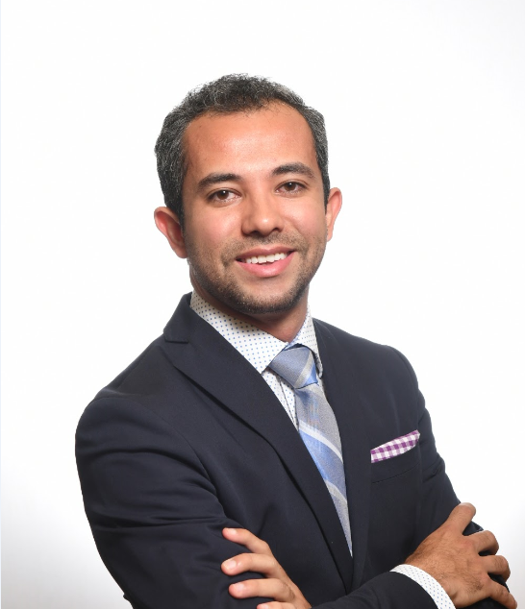
THE TEAM
PRESENTER
Gustavo Suarez
MANAGER
KEY EMPLOYEE
First Last
First Last
WWW.JPGTEAM.COM

Slide 14
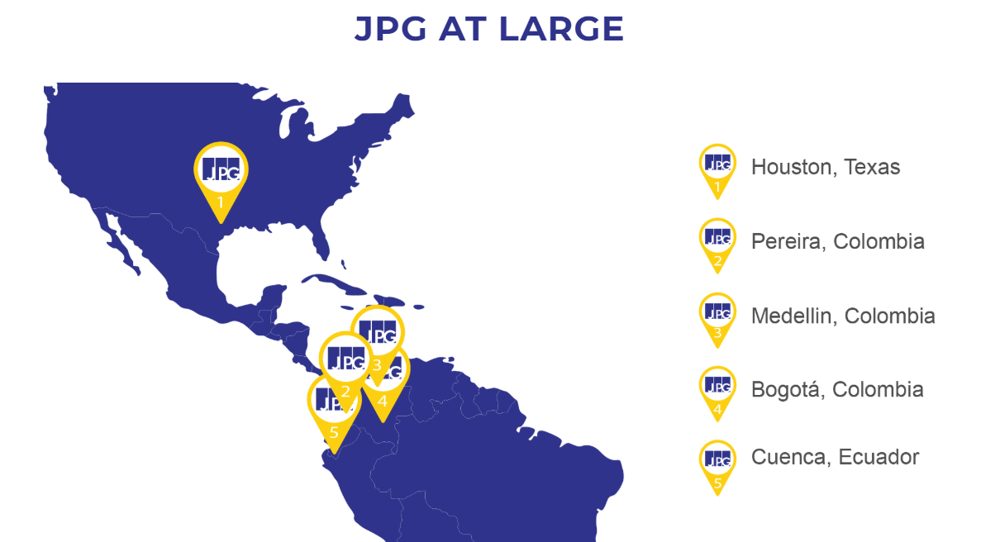
@JPGSMALLBIZ
Email: gsuarez@jpgtax.net
Customer Service: 281-738-1734
WWW.JPGTEAM.COM

